Slide 1
Acquisition of Chess Knowledge in AlphaZero
Authored By:
Thomas McGrath, Andrei Kapishnikov, Nenad Tomasev, Adam Pearce, Demis Hassabis, Been Kim, Ulrich Paquet, and Vladimir Kramnik
Presented By:
Eric Hansen
Robin Na
Prayaag Venkat

Slide 2

Learning from machines (AlphaZero)
Most methods we have looked so far try to interpret algorithms trained on human-generated data and labels
These interpretations may resemble human-understandable representations only because they learned from such data
Can we interpret what the algorithms has been learning through its self-play training process?

Slide 3
Learning from machines - three pronged acquisition
Probe for concepts
How closely is AlphaZero’s internal representation related to chess concepts humans have already created?
Detection of human concepts from network activations
Study behavioral changes
How do changing representations give rise to changing behaviors?
Evolution of AlphaZero vs. human’s strategy in openings
Investigate activations directly
Unsupervised methods using non-negative matrix factorisation (NMF) and direct measure of covariance to discover concepts not represented by humans in the past

Slide 4
Interpretability
Concept-based (post-hoc) interpretability
Network probing / important features / mechanistic understanding
Challenges: correlation not causal
Explainability in reinforcement learning
Structural causal models / reward difference explanations
Identify interesting points in behavioral trajectories

Slide 5
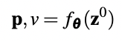
Chess as testing ground for AI interpretability
Can human learn the machine’s strategy?
Does not rely on human-labeled data
Tree-based organization / saliency maps
Natural language processing to generate move-by-move commentary
This paper: captures “intuitive” aspect of chess play by understanding networks that produce value assessment (v) and candidate move (p)

Slide 6
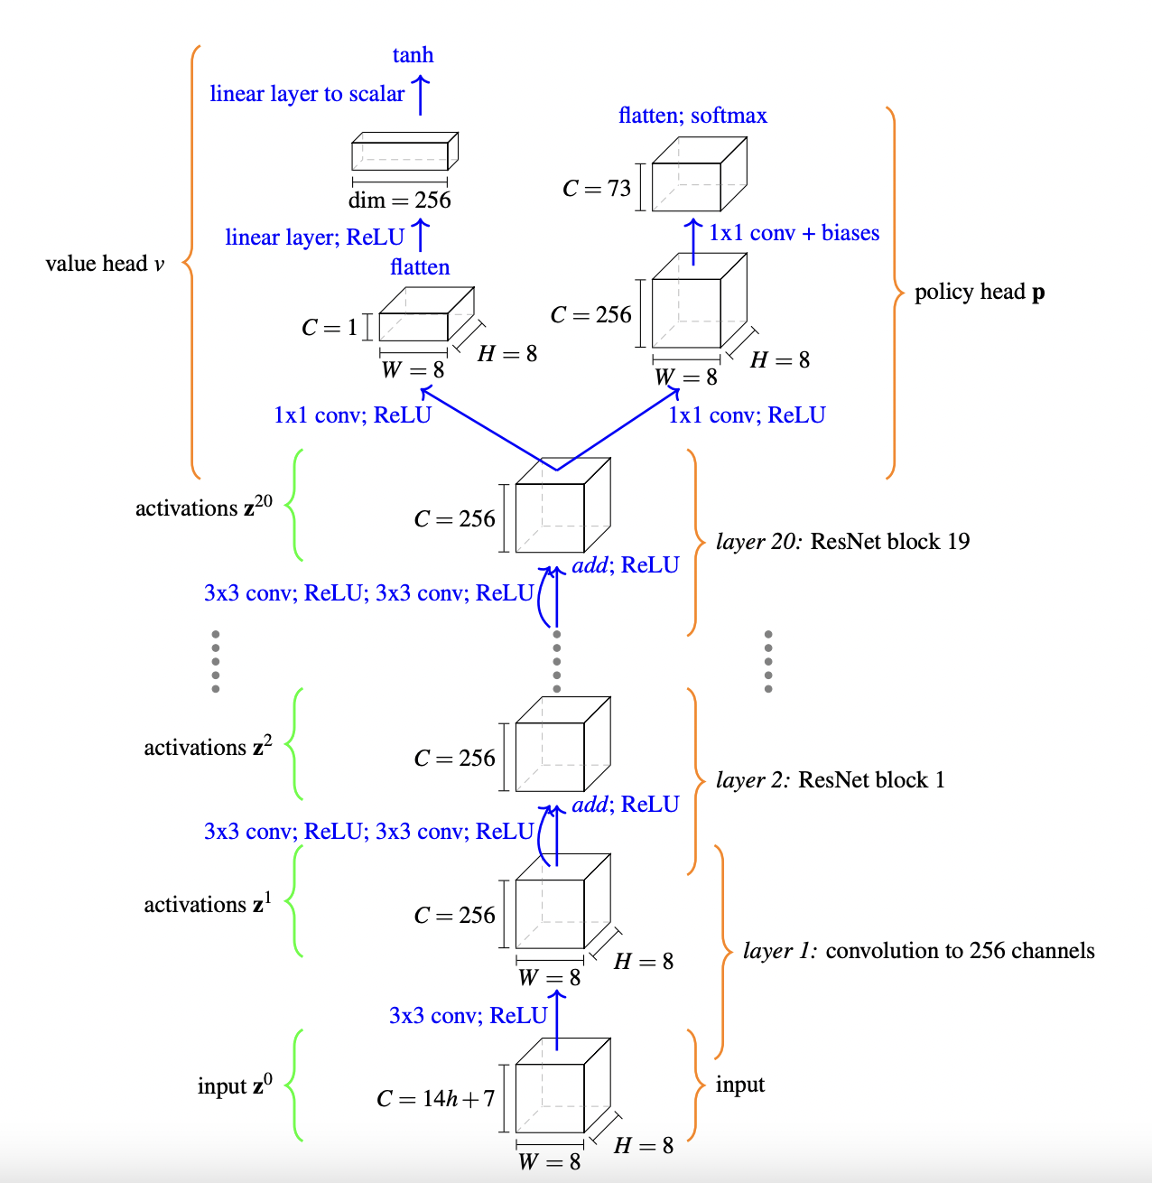
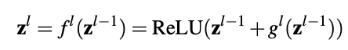
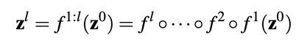
AlphaZero: Network structure and training

Slide 7
Probing for concepts

Slide 8
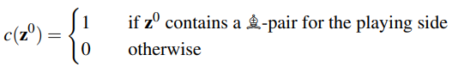
Encoding of human conceptual knowledge
Question: Can human concepts be easily predicted from network’s internal representation?
Concept: User defined function mapping network input to real line.
Approach: Train a sparse linear regression model from activations z^{l} at layer l and training step t to human concept j
Notes:
Explain why sparse

Slide 9
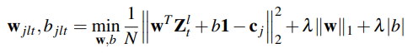
Probing concept learning: details
Data: Randomly sample training, validation, test data from ChessBase archive, compute concept values and AlphaZero activations
Procedure: For concept j, layer l, training step t, solve
Controls: Regression from z⁰ and random concept regression.
Evaluation: R² value, fraction of variance in concept explained by network activation
Notes:
Piece value Simple values for material are one of the first things a beginner chess player learns, and allow for basic assessment of a position. We began our investigation of the value function by using only piece count difference as the ‘concept vector’. In this case, similar to [69], the vector c(z 0 ) = [dp(z 0 ),dN(z 0 ),dB(z 0 ),dR(z 0 ),dQ(z 0 )] contains the difference d in numbers of pawns, knights, bishops, rooks and queens between the current player and the opponent. For piece value regression we use only positions where at least one piece count differs between White and Black. The evolution of piece weights are shown in Figure 4b, showing that piece values converge towards commonly-accepted values after 128,000 training steps

Slide 10
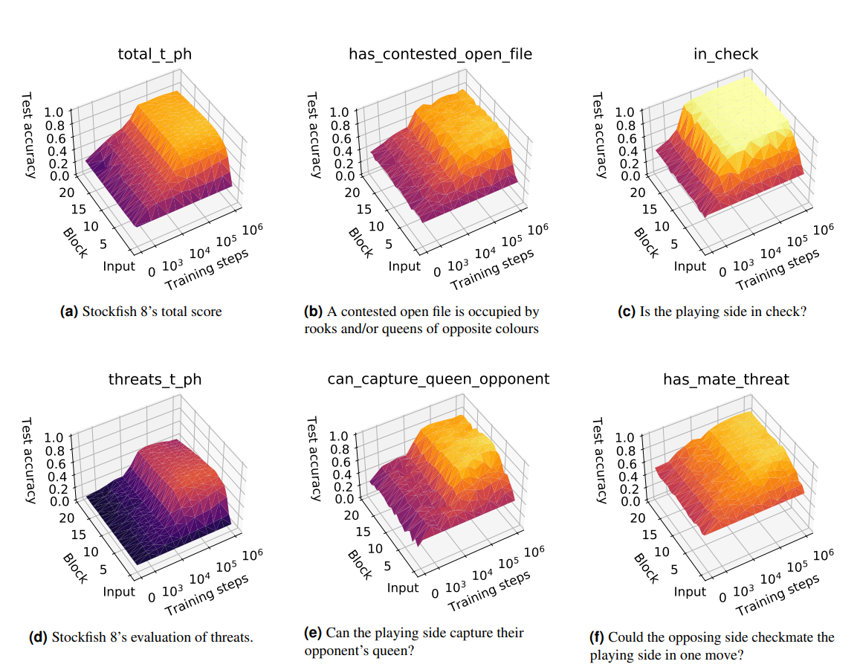
Evolution of human concepts in AlphaZero

Slide 11
Key findings
Grokking: Many concepts begin to increase in accuracy around 32,000 steps
Drop in linearly-available information in later layers for some concepts
Some concepts cannot be regressed: sparsity partially obstructs ability to relate highly-distributed representations to concepts
Learning from prediction errors: regression errors may point to a “difference of opinion” with Stockfish

Slide 12
Challenges for concept probing
What’s the right probing architecture?
How should we interpret complex or subjective concepts?
When can we definitively say a concept is represented?
When we train a probe, we cannot tell if we are getting a confounder or the concept itself

Slide 13
Progression through AlphaZero and human history

Slide 14
Progression of knowledge
Recall:
Question: How does the progression of AlphaZero’s knowledge compare to that of humans?
Key Findings:
AlphaZero: Start from a uniform prior, then narrow down.
Humans: Start from a concentrated prior, then expand.

Slide 15
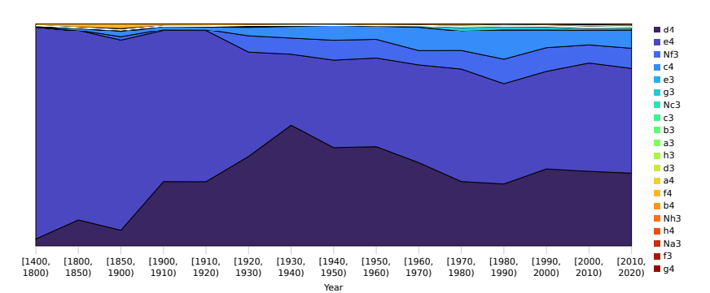
Progression through human history

Slide 16
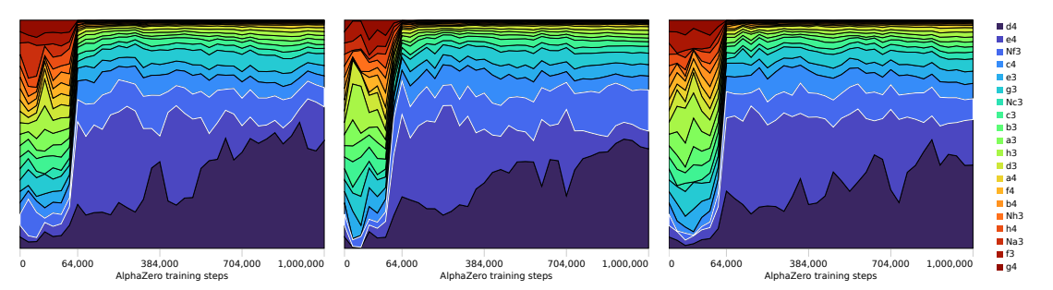
Progression through AlphaZero history

Slide 17
Progression of AlphaZero’s Chess Knowledge
Methodology
At different training steps (up to 128k), examine:
AlphaZero’s move tendencies
AlphaZero’s concept encodings
Primary Takeaways
AlphaZero’s learns standard opening theory early on
AlphaZero learns material values before more complex positional concepts
Both reinforce idea that AlphaZero learns basic human chess concepts first
Notes:
Figure 7a shows that after 25k training iterations, 1. d4 and 1. e4 are discovered to be good opening moves, and are rapidly adopted within a short period of around 30k training steps. Similarly, AlphaZero’s preferred continuation after 1. e4 e5 is determined in the same short temporal window. Figure 7b illustrates how both 2. d4 and 2. Nf3 are quickly learned as reasonable White moves, but 2. d4 is then dropped almost as quickly in favour of 2. Nf3 as a standard reply. Looking beyond individual moves, we group AlphaZero’s responses to 1. e4 into two sets, 1. . . c5, c6, e5 or e6 and then all 16 other moves. Figure 7c shows how 1. . . c5, c6, e5 or e6 together account for 20% of the prior mass when the network is initialized, as they should, as they are four out of twenty possible Black responses. However, after 25k training steps their contribution rapidly grows to account for 80% of the prior mass

Slide 18
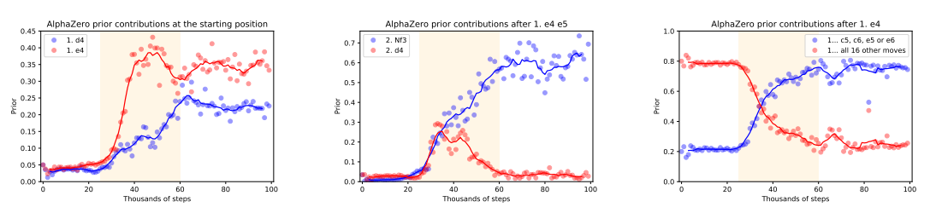
Opening Theory Knowledge
~30-60k: AlphaZero plays 1. e4/d4 the majority of the time
~45k: AlphaZero considers 2. d4 before opting for 2. Nf3
~45k: AlphaZero plays standard responses to 1. e4

Slide 19
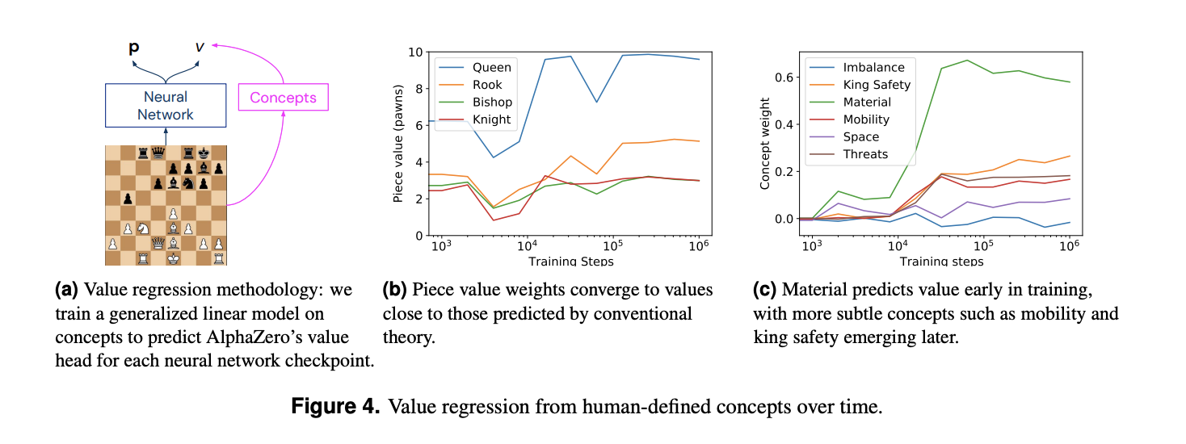
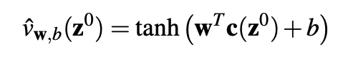
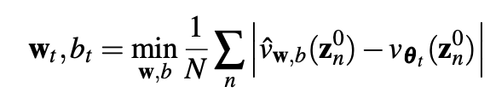
Material vs. Positional Knowledge
~30k training steps: Piece Values develop, converge ~100k
King Safety, Mobility concepts emerge after Material
More complex concepts require more training time
Notes:
During the course of AlphaZero’s million training steps, there is an inflection point where the network understands “enough” about piece value that playing basic opening sequences (like playing 1. e4 and not 1. f3) lead to tangible advantages.
From the evidence we have in Section 4.6, notably Figure 4, Stockfish’s evaluation sub-function of material is strongly indicative of the AlphaZero network’s value assessment. Figure 4 suggests that the concept of material and its importance in the evaluation of a position is largely learned between training steps 10k and 30k, and then refined.
Furthermore, the concept of piece mobility is progressively incorporated in AlphaZero’s value head in the same period. It is plausible that a basic understanding of the material value of pieces should precede a rudimentary understanding that greater piece mobility is advantageous. 6.1 Discovery of standard openings
In this section we examine the discovery of standard openings. Evidence suggests recognizable opening theory develops between 25k and 60k training steps, after the period between 10k and 30k steps when knowledge of basic material value is acquired.
Simple values for material are one of the first things a beginner chess player learns, and allow for basic assessment of a position. We began our investigation of the value function by using only piece count difference as the ‘concept vector’. In this case, similar to [69], the vector c(z 0 ) = [dp(z 0 ),dN(z 0 ),dB(z 0 ), dR(z 0 ),dQ(z 0 )] contains the difference d in numbers of pawns, knights, bishops, rooks and queens between the current player and the opponent. For piece value regression we use only positions where at least one piece count differs between White and Black. The evolution of piece weights are shown in Figure 4b, showing that piece values converge towards commonly-accepted values after 128,000 training steps We approximate piece values from the weights of a linear model that predicts the game outcome from the difference in numbers of each piece only. As background, the real AlphaZero evaluation v in (p, v) = fθ(s) is the output of a deep neural network with weights θ

Slide 20
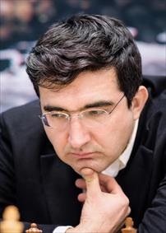
Training Progression Assessment: GM Vladimir Kraminik
16k to 32k: Material Value in Complex Positions
32k to 64k: King Safety in Imbalanced Positions
64k to 128k: King Safety & Material Sacrifices in Complex Positions
Tactical skills appear to precede positional skills as AlphaZero learns
Notes:
At 16k, AlphaZero fails to accurately assess material in complex positions, leading to undesirable exchange sequences and ultimately losing games on material. AlphaZero at 32k has a more solid grasp and capitalizes correspondingly
The 32k version underestimates the attacks and long-term material sacrifices of the 64k version and may overestimate the potential of its own attacks, resulting in losing positions. 64k appears to be also stronger in all aspects
128k has a much deeper understanding of which attacks will succeed and which would fail, allowing it to sometimes accept material sacrifices made by 64k for purposes of attack, yet then proceed to defend well

Slide 21
Exploring Additional Feature Detectors in AlphaZero Network

Slide 22
Exploring Activations with Unsupervised Methods
Goal: Find Feature Detectors embedded within Network
Methods:
Non-Negative Matrix Factorization of each layer’s channels
Correlation of Input Board with each channel’s activations
Primary Takeaway
Individual network layers & channels encode feature detectors related to human-recognizable chess concepts

Slide 23
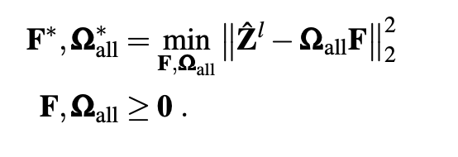
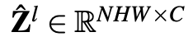
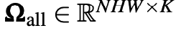
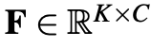
Approach #1: NN Matrix Factorization Analysis
For each layer l with C channels,
Compute a matrix factorization Ω x F using K < C columns
For each factor k (1…K) and input n (1…N)
Visualize activations on Chess Board to find feature detectors
Notes:
It means the compression would be into a matrix Ω ∈ R HW×K. In the reduced representation, the rows of Ω correspond to squares, and its entries are K weights that sum together non-negative global factors fk ∈ R C for k = 1,...,K so that the original row in zˆ l is closely approximated. If the factor matrix F ∈ R K×C contains the global factors as columns, the activations are approximated with zˆ l ≈ ΩF. For brevity we omit the dependence of the factor and weight matrices on the layer index l

Slide 24
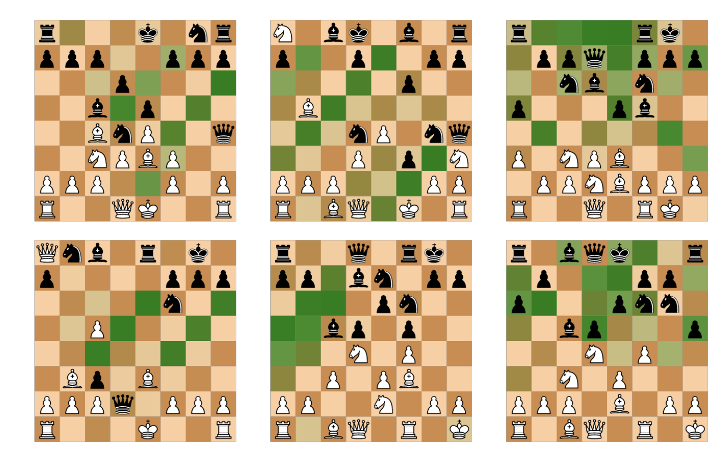
Results: NN Matrix Factorization Analysis
Diagonal Moves
(1st Layer)
Diagonal Moves (2nd Layer)
# of Pieces that could move to each square
Notes:
Using 36 factors per block, the full NMF dataset consists of 720 block/factor pairs. We report selected factors below, and the full dataset is available online
https://storage.googleapis.com/uncertainty-over-space/alphachess/index.html
The factors shown in Figure 8a and Figure 8b show the development of potential move computations for the player’s and opponent’s diagonal moves respectively. In the first layer moves of only three squares or fewer are shown (and only those towards the upper right of the board), demonstrating that move calculations take multiple blocks to complete. The convolutional structure of the AlphaZero network means that all computations from one layer to the next involve only spatially adjacent neurons. Because of this, move computations must occur over the course of multiple layers. This partially explains the gradual increase in predictive power over the initial layers for threat-related concepts shown in Figure 2b. Figure 8c shows a more complex factor in layer 3: a count of the number of the opponent’s pieces that can move to a given square (darker weights indicates more pieces can move to that square). This factor is likely to be useful in computing potential exchanges, and indicates that AlphaZero is also considering potential opponent moves even early in the network. Figure 8d appears to show potential moves for the current player - darker squares indicate better moves (for instance the opponent’s hanging queen on d2).

Slide 25
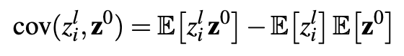
Approach #2: Input-Activation Covariance Analysis
For each layer l and channel i,
Compute the covariance between input z0 and position activations
Visualize covariances on Chess Board to find feature detectors
Notes:
There are also a number of global positions that appear in the covariance visualizations in Figure 10. It is because of correlations in the data: the features they detect are globally correlated to other piece positions on the board in the sample of grandmaster chess positions. As an example, activation i = (5,4,6) detects the pattern (pd3, Be3, Nf3) with both rows (d4, e4, f4) and (d5, e5, f5) in front of it being empty. This piece pattern predominantly appears in certain opening positions and almost never elsewhere in middle- and endgames, and hence rooks on a1 and a8 are also visible

Slide 26
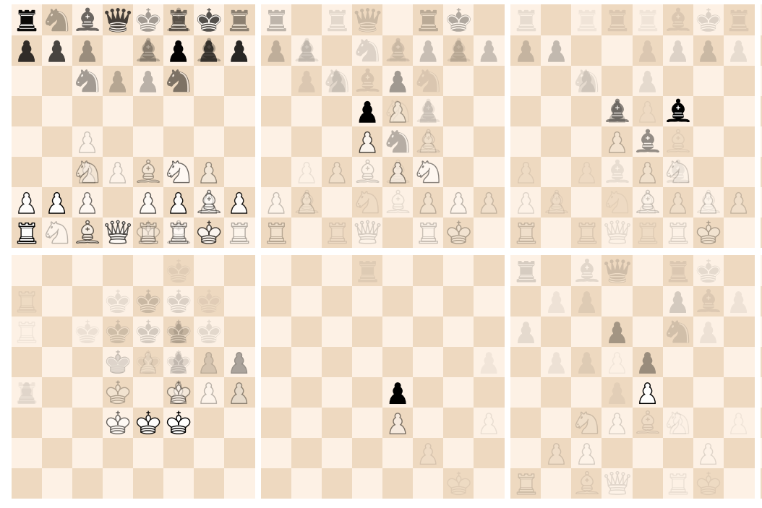
Results: Input-Activation Covariance Analysis
First-Layer Feature Detector: Frequent Early/Mid/Late-Game Positions
Due to (representative) correlation within the training data

Slide 27
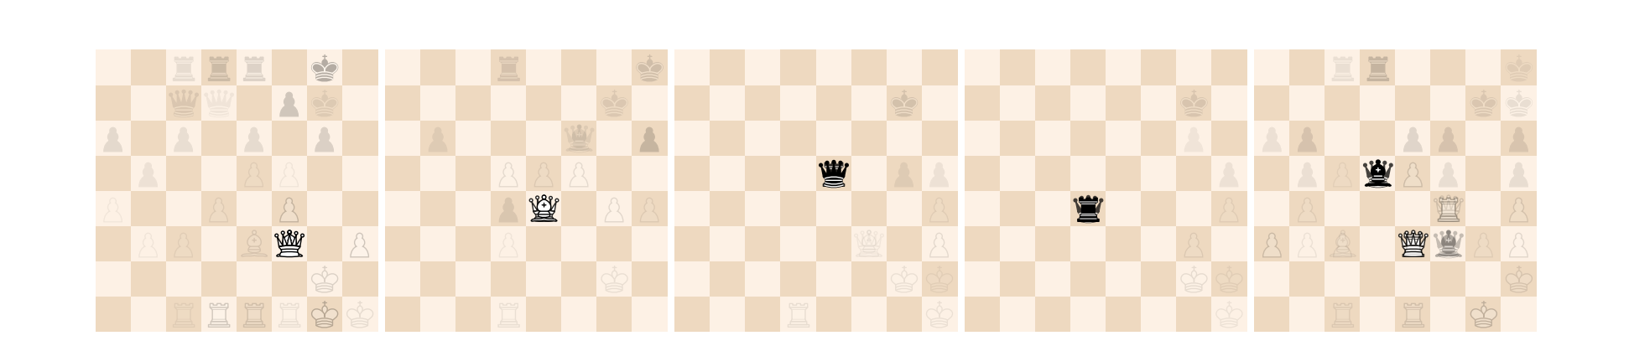
Results: Input-Activation Covariance Analysis
Detecting Move-Types from a Square
1-2) Diagonal-Attacking Pieces (Queen, Bishop)
3-4) Horizontally-Attacking Pieces (Queen, Rook)
5) Both
5 covariances with different channels for the square (5, 4)

Slide 28
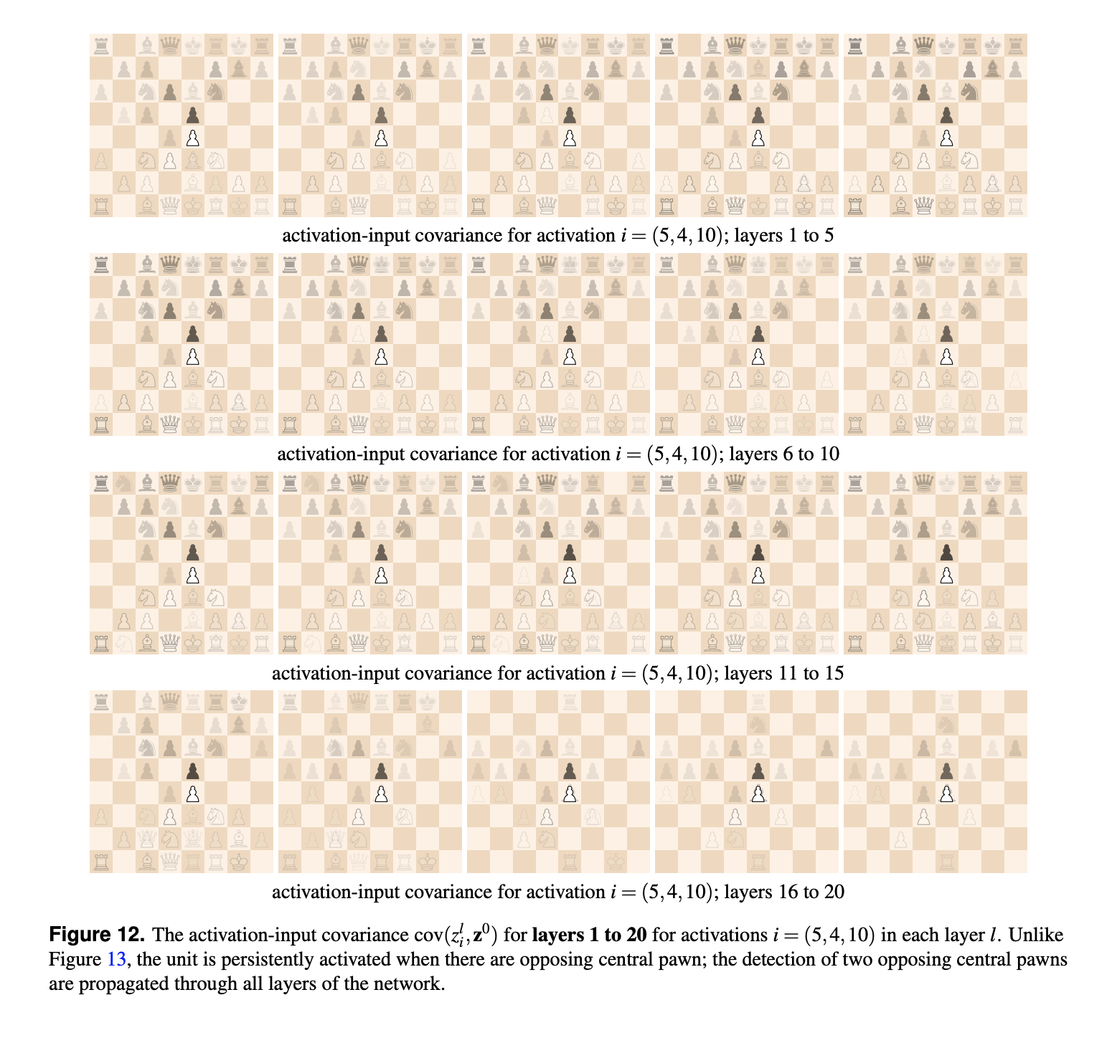
Results: Input-Activation Covariance Analysis
Feature Detection Propagating through Layers (1 channel)
Centrally Opposing Pawns
Covariances with other pieces dissipates
Layers 1 to 5
Layers 16 to 20

Slide 29
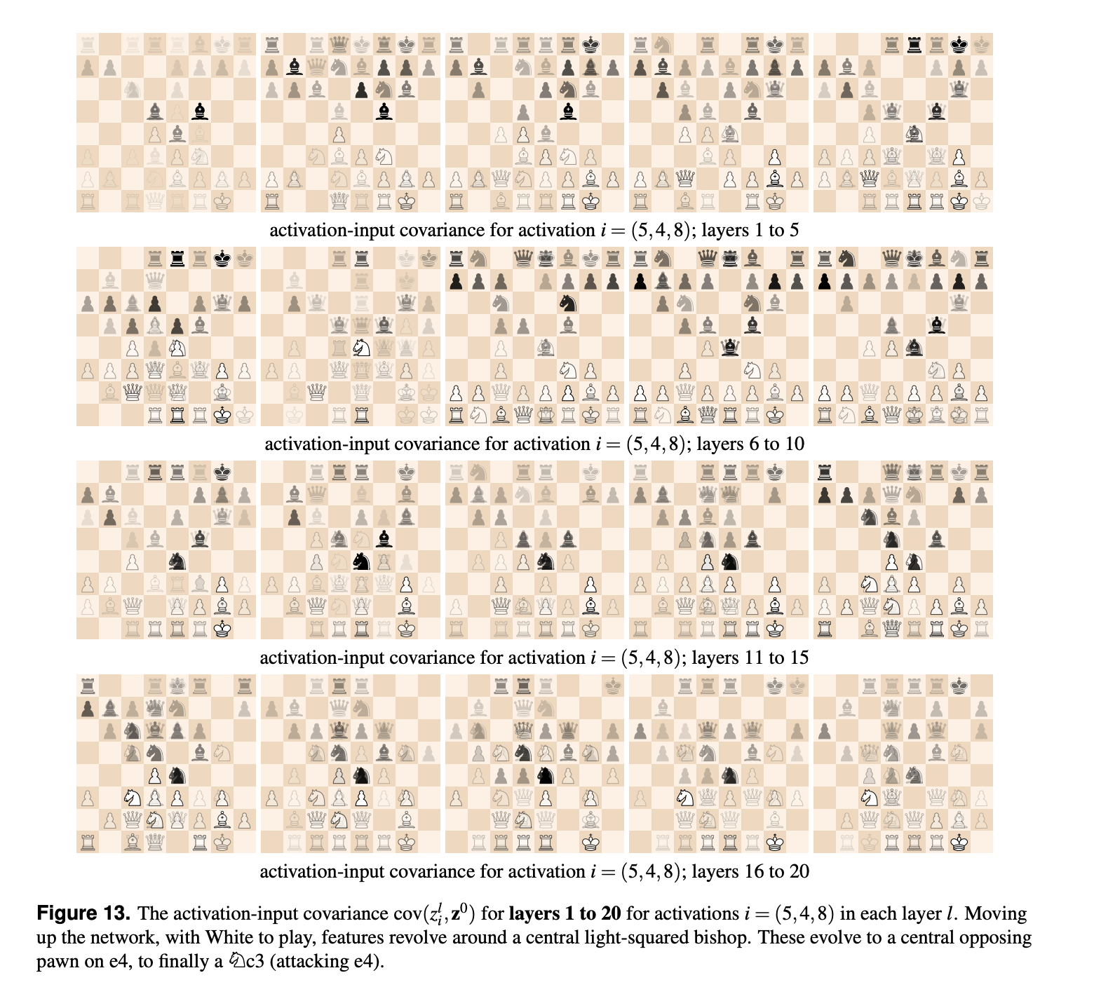
Results: Input-Activation Covariance Analysis

Slide 30
Conclusion - Key Findings
Human-Defined Concepts can be regressed from the AlphaZero network
Despite never being trained on a human game of chess
As training progresses, AlphaZero understands basic concepts (openings, material) before more complex ones (king safety, mobility)
Feature Detectors of human-recognizable chess concepts are encoded by individual layers + channels in AZ Network
Can be found using supervised & unsupervised techniques

Slide 31
Limitations
Challenges for Concept Probing (previous slide)
Knowledge acquisition is not complete - only a very small part of the model
Interpreting “Feature Detectors” found via Unsupervised techniques
Inherently subjective
No Causal Insight into the Learned Concepts (only correlation)
Notes:
Hyperparameter Configuration Dependence
Experiments likely, but not necessarily robust to other training configurations

Slide 32
Future Research Areas
Addressing Concept Probing Limitations (more than sparse LR)
Can we go beyond finding human knowledge embedded in AlphaZero and understand what new concepts are learned?
Further analysis of feature detectors found with unsupervised techniques
How do we generalize these findings to other machine learning settings? Could we find human-recognizable concepts in different trained models?

Slide 33
Discussion
How is this paper different from methods we discussed so far?
In terms of goals / techniques / specific models to explain
Does this approach (or anything that can be built up on this) have potential applications for a more general setting other than board games?
What are the pros/cons of using games/artificial environments as baseline for evaluating RL algorithms?
Can this be applied to our practice of doing science?
Can we recreate or extract theories using similar frameworks (AI for science)?
How should we define or understand “knowledge” in these settings?
How is it different from similar to concepts/models/explanations/information?
How convinced are you convinced about the “interpretability” aspect?
Who would be potential audience that could benefit from such analysis?

